Slide 1
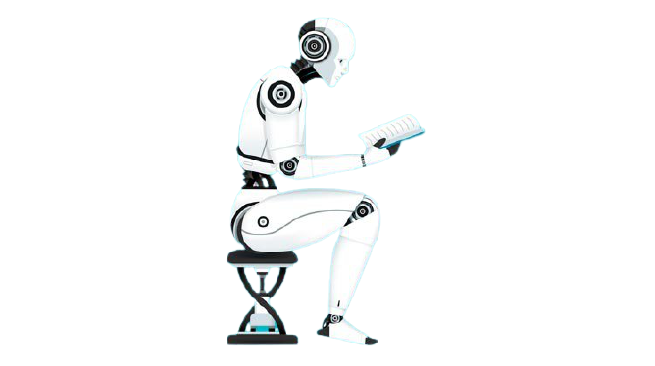
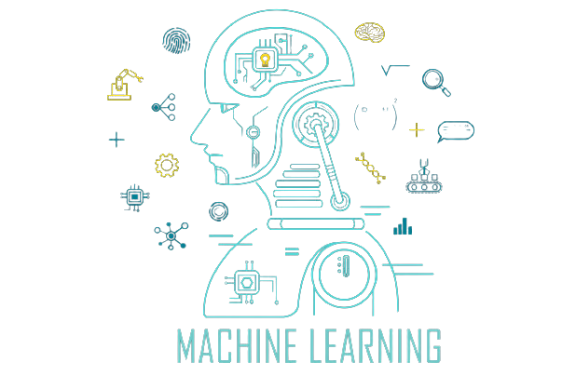
SHASWAT SAHU
ENG19CS0294

Slide 2
INTRODUCTION TO MACHINE LEARNING
A branch of artificial intelligence, concerned with the design and development of algorithms that allow computers to evolve behaviors based on empirical data.
As intelligence requires knowledge, it is necessary for the computers to acquire knowledge.
Machine learning refers to a system capable of the autonomous acquisition and integration of knowledge

Slide 3
WHY Machine learning
No human experts
industrial/manufacturing control.
mass spectrometer analysis, drug design, astronomic discovery.
Black-box human expertise
face/handwriting/speech recognition.
driving a car, flying a plane

Slide 4
Contd.
Rapidly changing phenomena
credit scoring, financial modeling.
diagnosis, fraud detection.
Need for customization/personalization
personalized news reader.
movie/book recommendation.

Slide 5
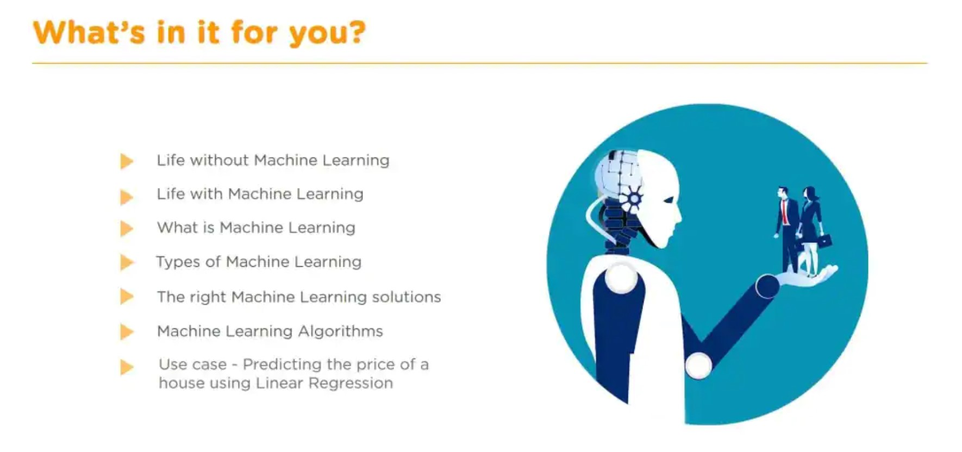

Slide 6
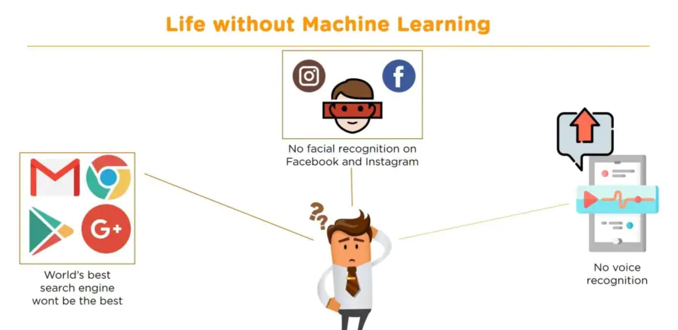

Slide 7
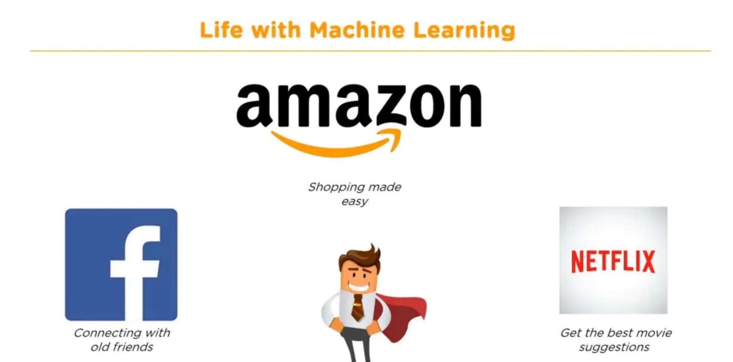

Slide 8
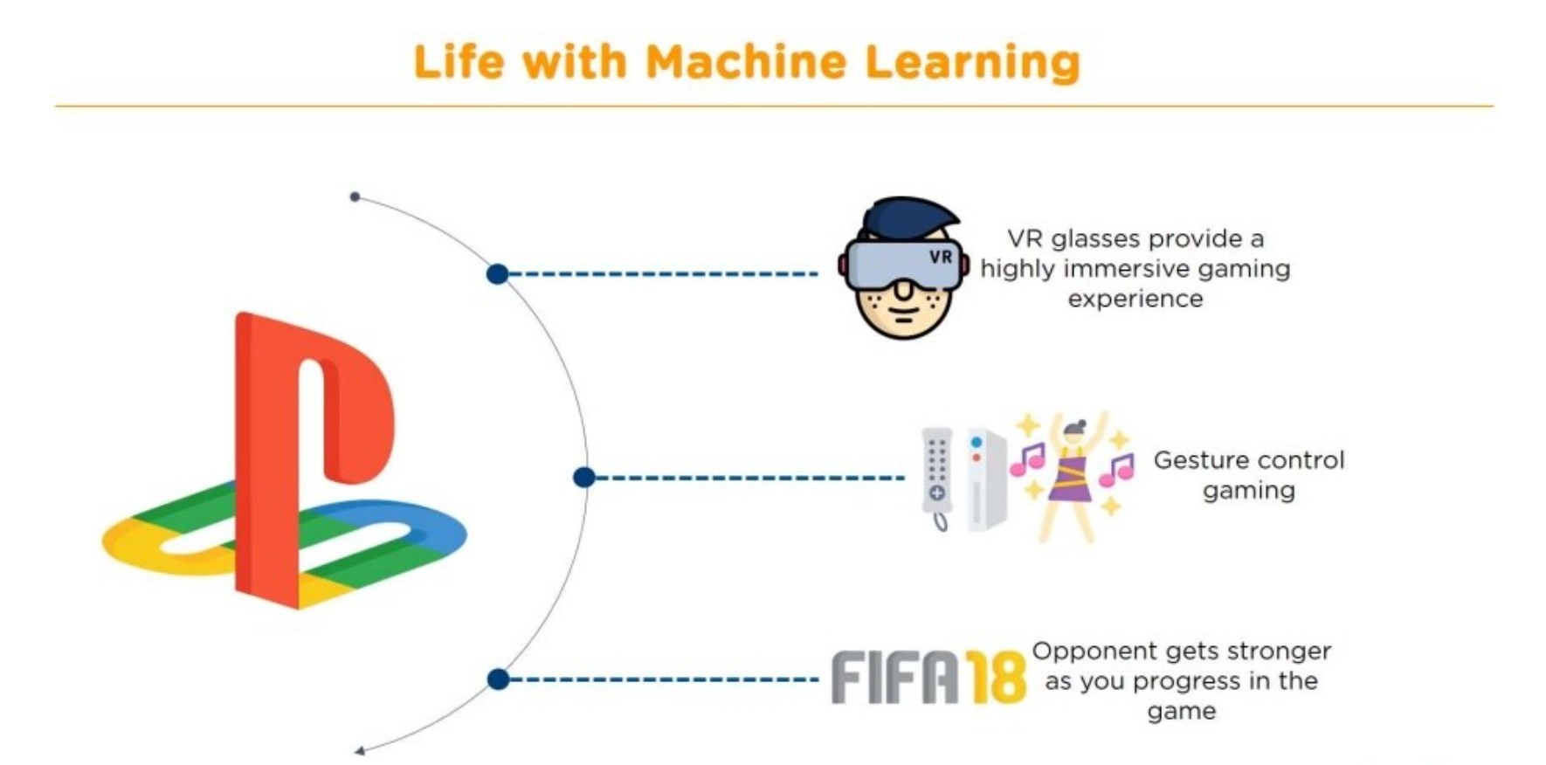

Slide 9
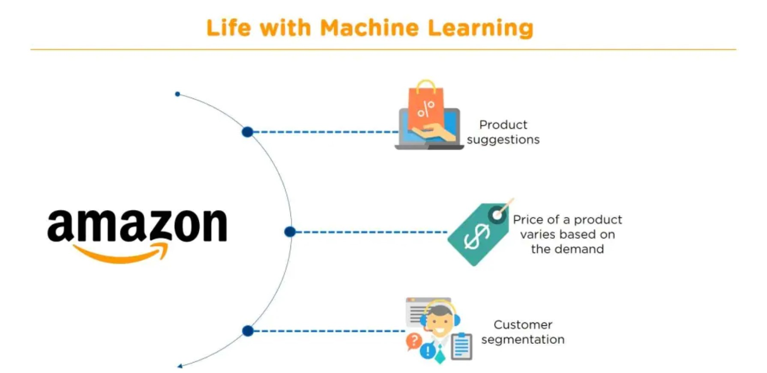

Slide 10
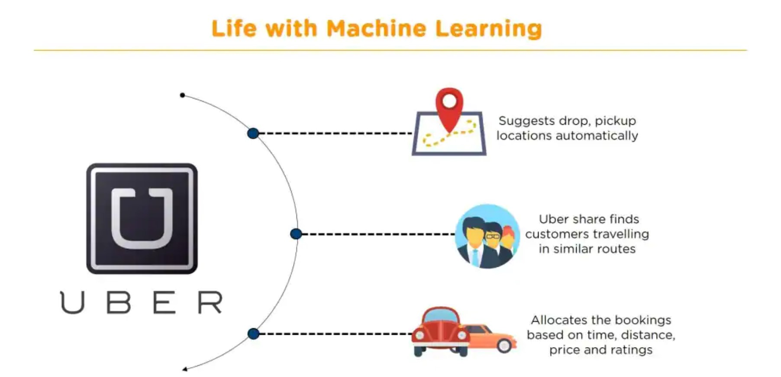

Slide 11
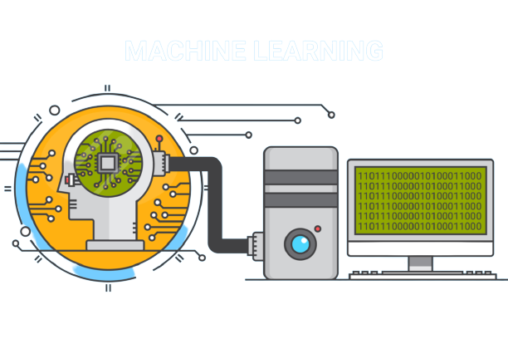

Slide 12
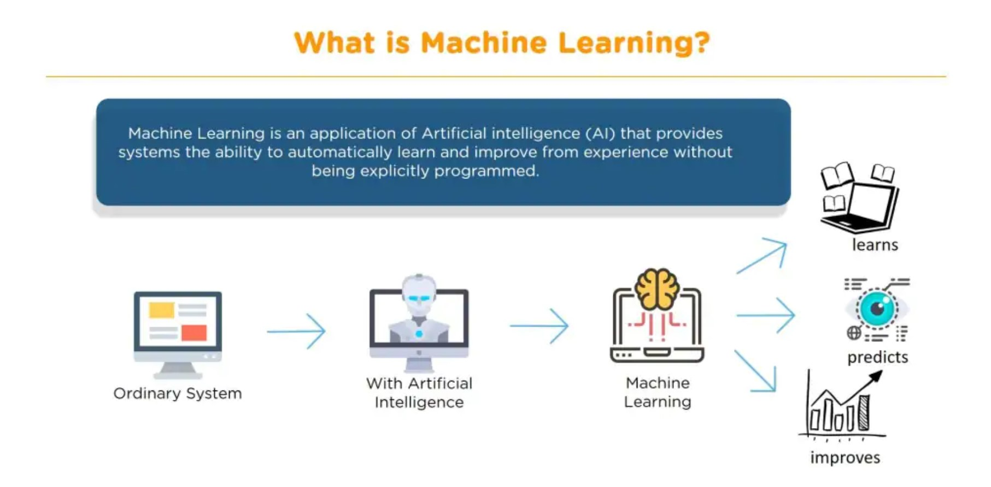

Slide 13
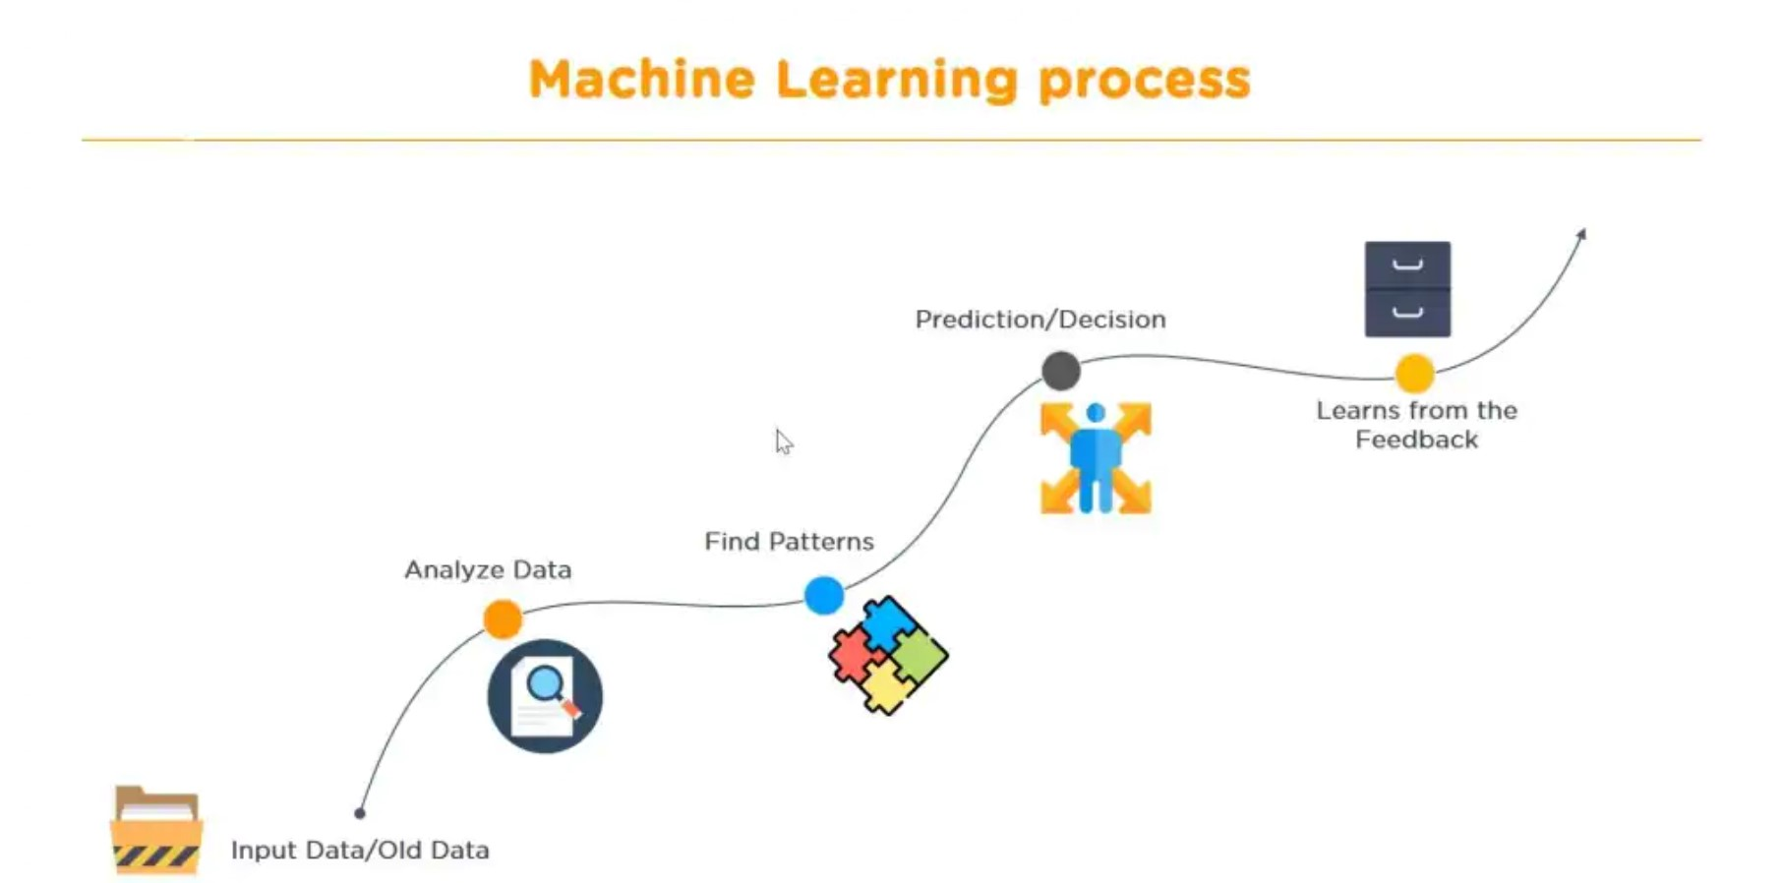

Slide 14
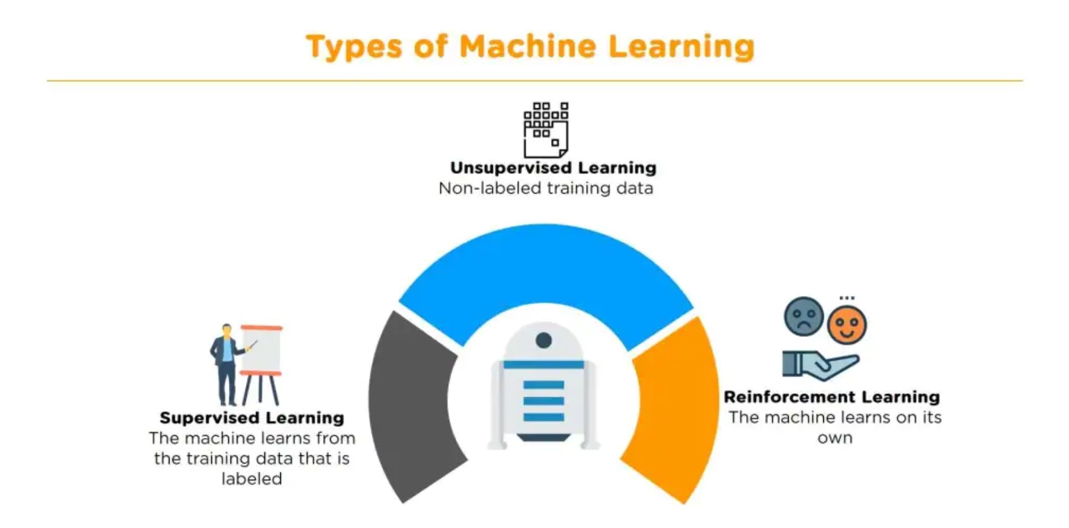

Slide 15
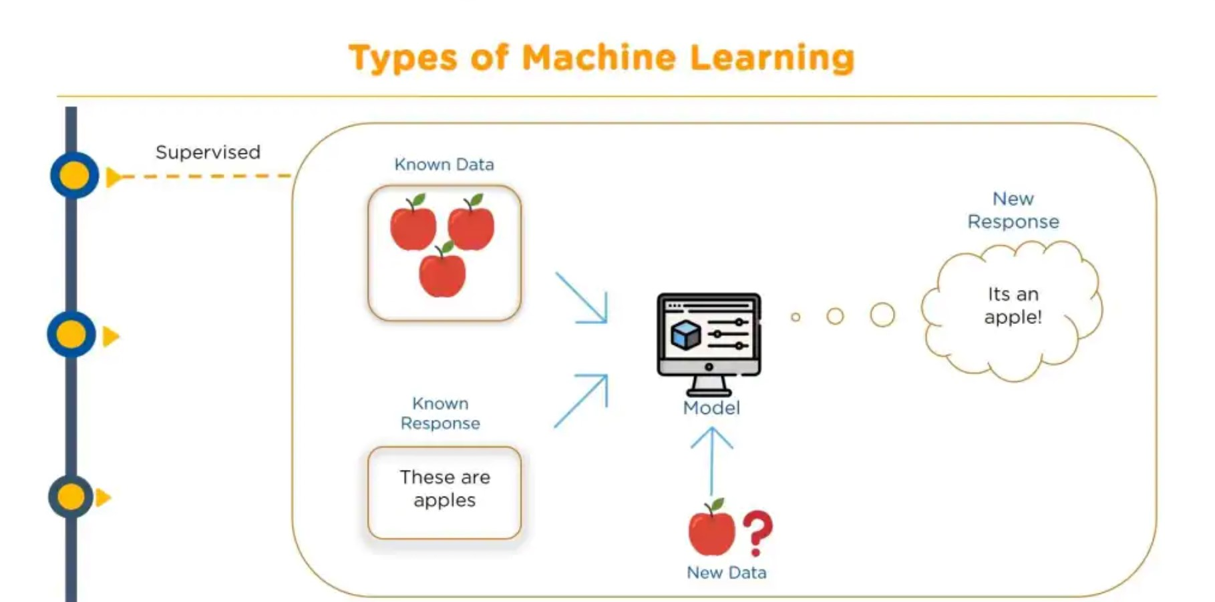

Slide 16
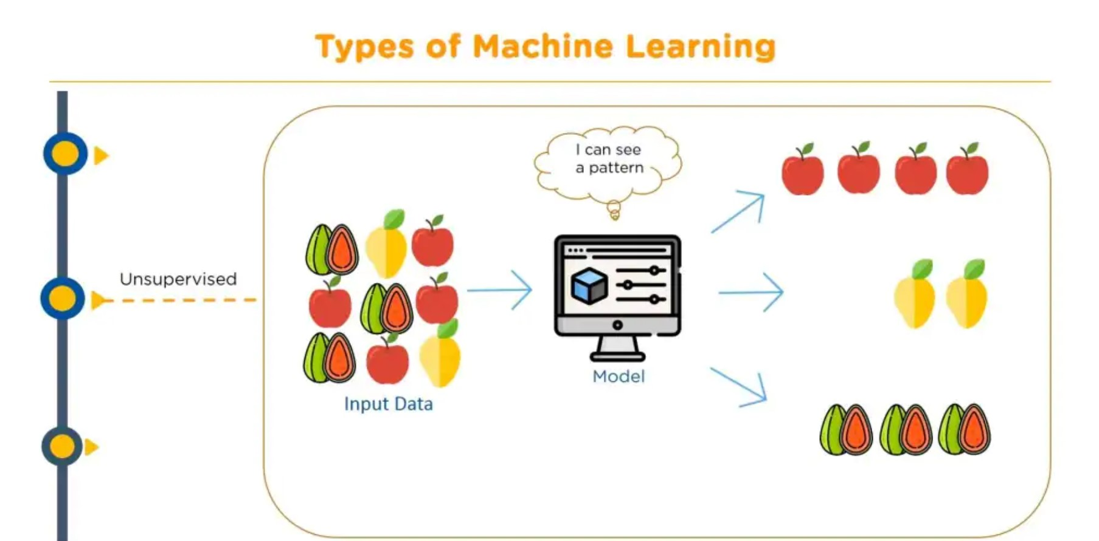

Slide 17
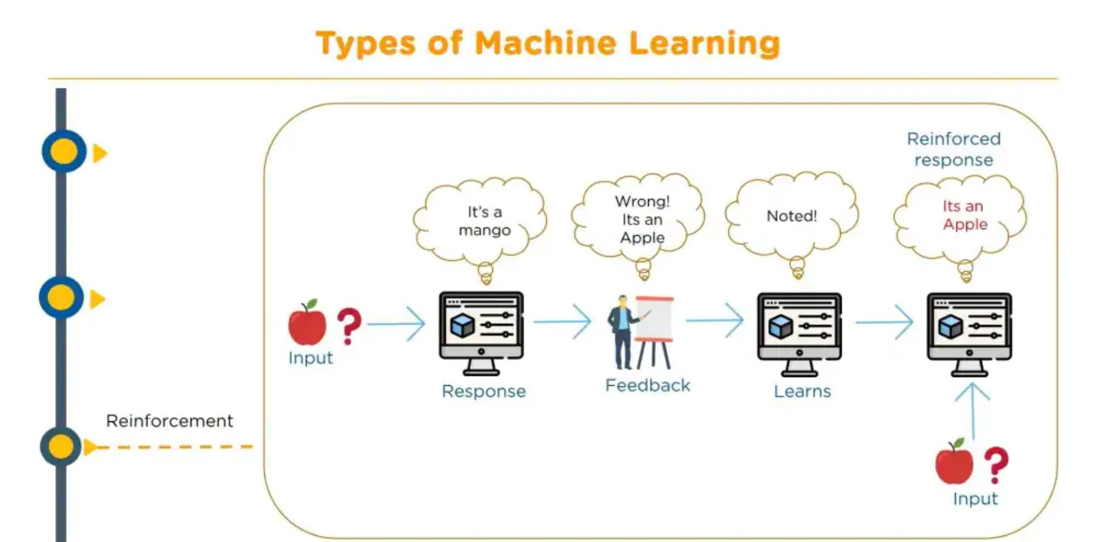

Slide 18
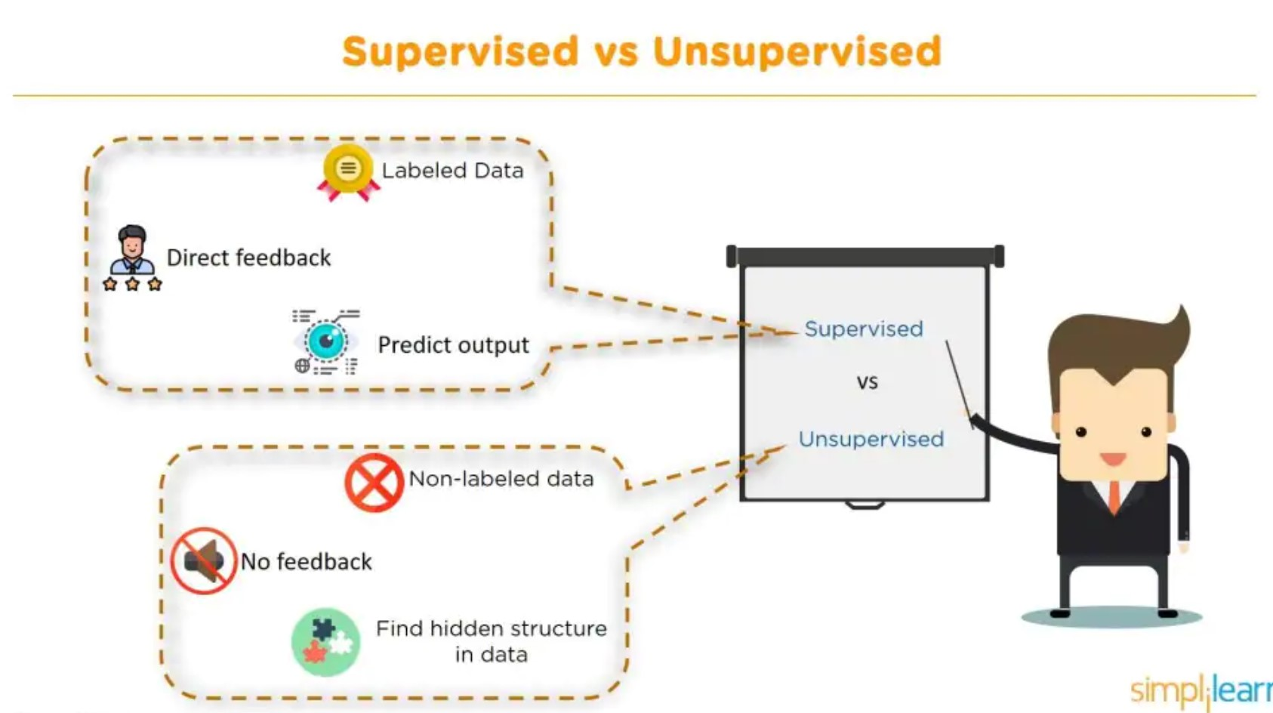

Slide 19
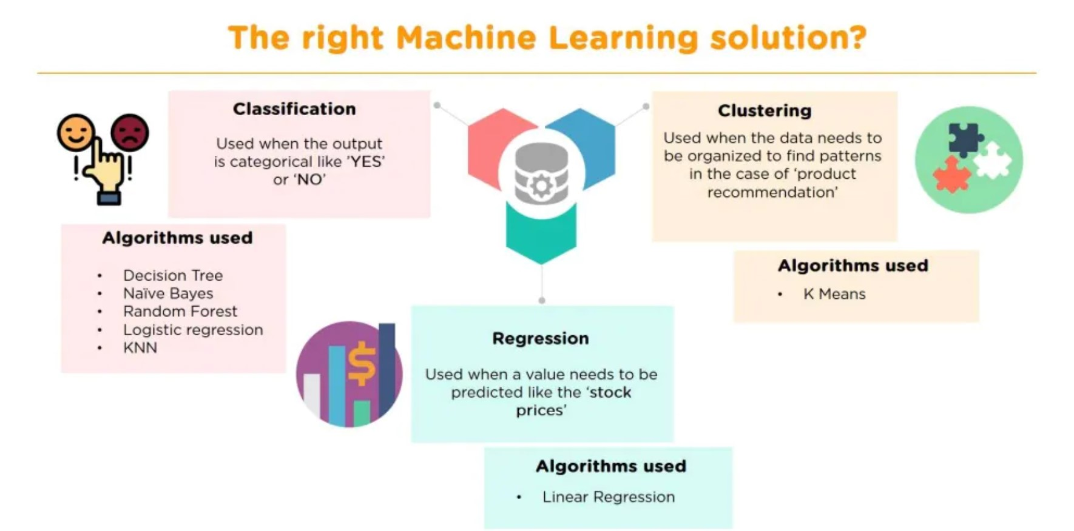

Slide 20
Linear Regression
Linear regression is a linear model, e.g. a model that assumes a linear relationship between the input variables (x) and the single output variable (y). More specifically, that y can be calculated from a linear combination of the input variables (x).
A linear regression line has an equation of the form Y = a + bX, where X is the explanatory variable and Y is the dependent variable. The slope of the line is b, and a is the intercept (the value of y when x = 0).
Linear Regression Algorithm can be used in ML when the data is present in a continuous trend where it predicts results of data such as:
If 1 pen costs 1 rupee 2 pens costs 2 rupees 3 pens cost 3 rupees 4 pens cost 4 rupees how much would 12 pens cost?
It will formulate that y=x and predict that 12 pens would cost 12 rupees.

Slide 21
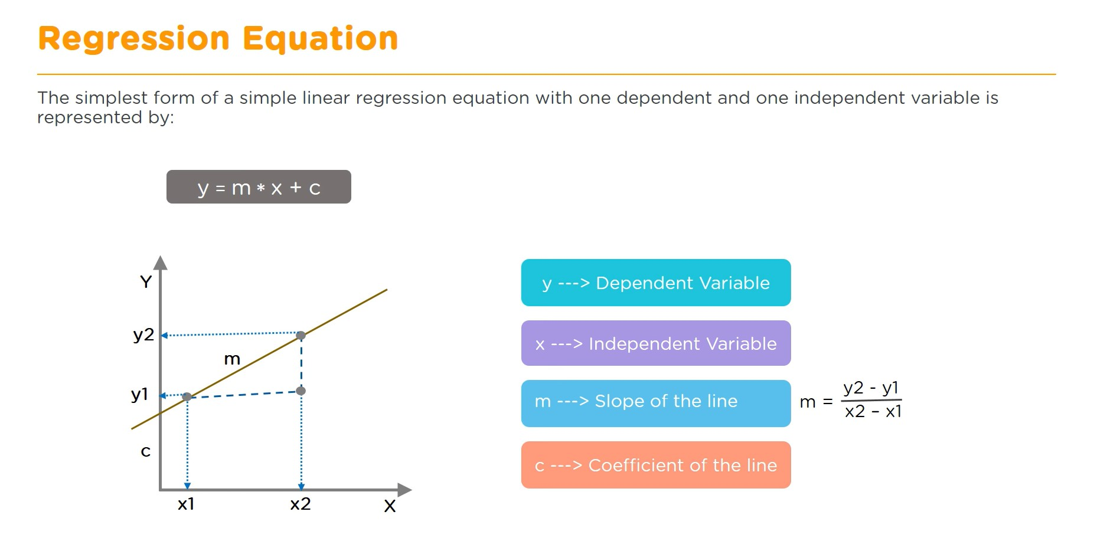

Slide 22
Logistic Regression
Logistic regression is named for the function used at the core of the method, the logistic function.
The logistic function, also called the sigmoid function was developed by statisticians to describe properties of population growth in ecology, rising quickly and maxing out at the carrying capacity of the environment.
This method is used to find the discrete dependent variable from the set of independent variables. Its goal is to find the best fit set of parameters.

Slide 23
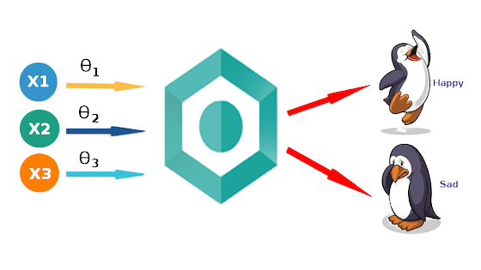
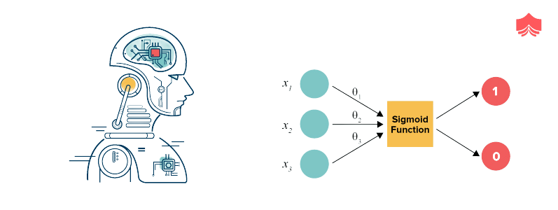

Slide 24
Decision Tree
Decision Trees are a type of Supervised Machine Learning (that is you explain what the input is and what the corresponding output is in the training data) where the data is continuously split according to a certain parameter.
Decision tree can be used to classification and regression both having a tree like structure.
The tree can be explained by two entities, namely decision nodes and leaves. The leaves are the decisions or the final outcomes. And the decision nodes are where the data is split.
Decision trees are built for making a training model which can be used to predict class or the value of target variable.

Slide 25
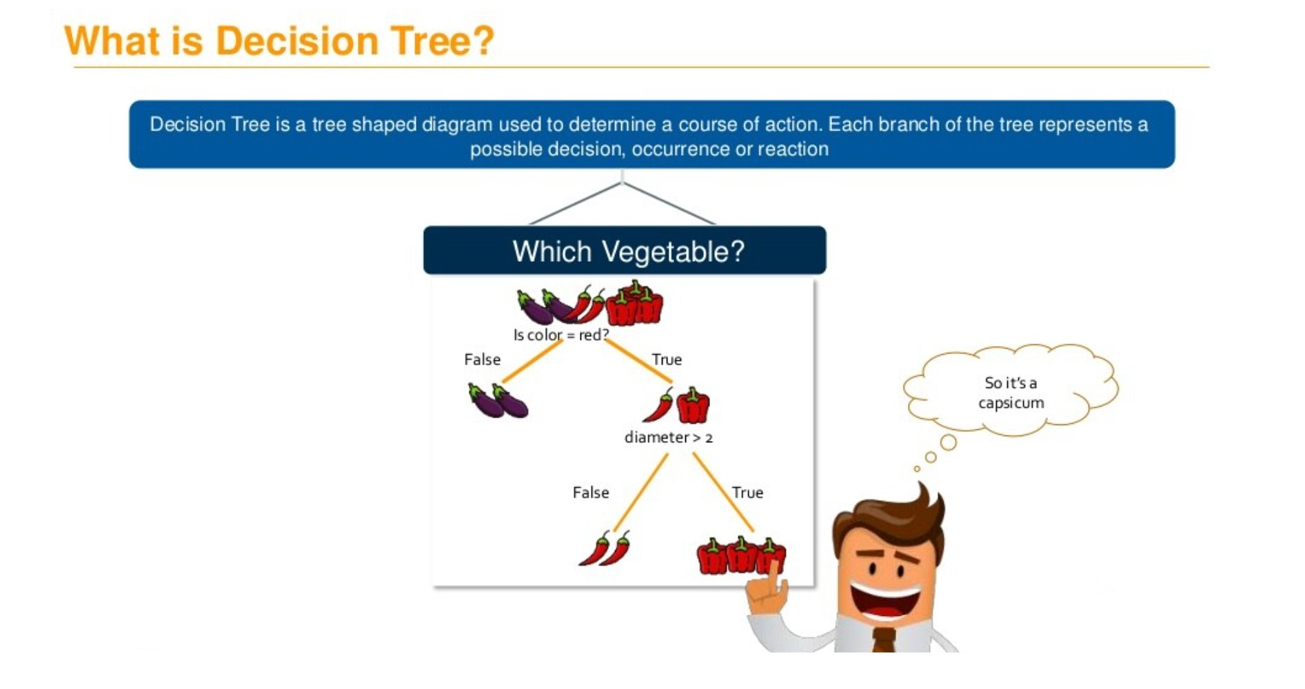

Slide 26
K-Nearest Neighbours
The abbreviation KNN stands for “K-Nearest Neighbour”. It is a supervised machine learning algorithm. The algorithm can be used to solve both classification and regression problem statements.
The number of nearest neighbours to a new unknown variable that has to be predicted or classified is denoted by the symbol ‘K’.
Let’s take a good look at a related real-world scenario before we get started with this awesome algorithm.
We are often notified that you share many characteristics with your nearest peers, whether it be your thinking process, working etiquettes, philosophies, or other factors. As a result, we build friendships with people we deem similar to us.
The KNN algorithm employs the same principle. Its aim is to locate all of the closest neighbours around a new unknown data point in order to figure out what class it belongs to. It’s a distance-based approach.

Slide 27
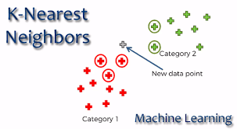

Slide 28
Random Forest
A random forest is a supervised machine learning algorithm that is constructed from decision tree algorithms.
A random forest is a machine learning technique that’s used to solve regression and classification problems. It utilizes ensemble learning, which is a technique that combines many classifiers to provide solutions to complex problems.

Slide 29
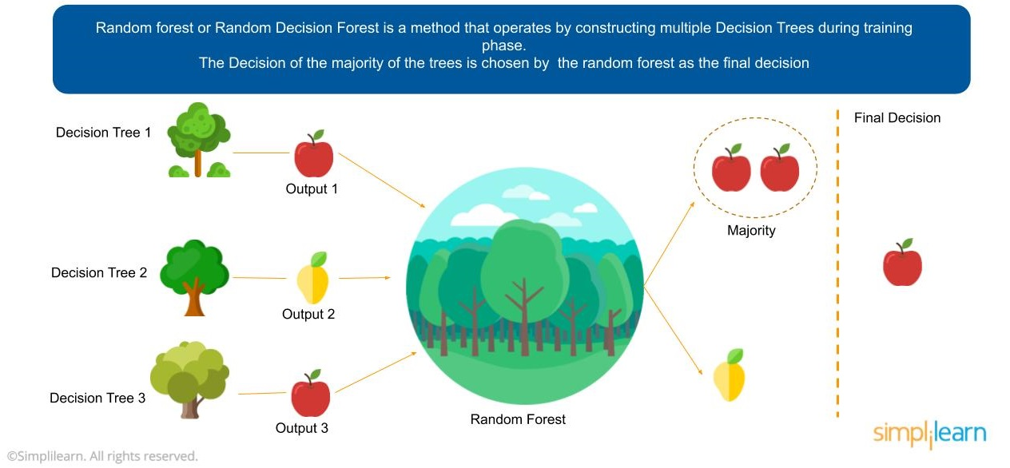

Slide 30
Support Vector Machine
“Support Vector Machine” (SVM) is a supervised machine learning algorithm that can be used for both classification or regression challenges.However, it is mostly used in classification problems. In the SVM algorithm, we plot each data item as a point in n-dimensional space (where n is a number of features you have) with the value of each feature being the value of a particular coordinate. Then, we perform classification by finding the hyper-plane that differentiates the two classes very well.
Support Vectors are simply the coordinates of individual observation. The SVM classifier is a frontier that best segregates the two classes (hyper-plane/ line).

Slide 31
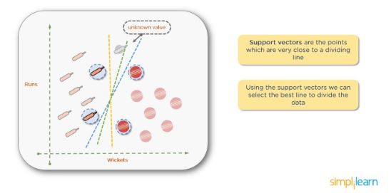

Slide 32
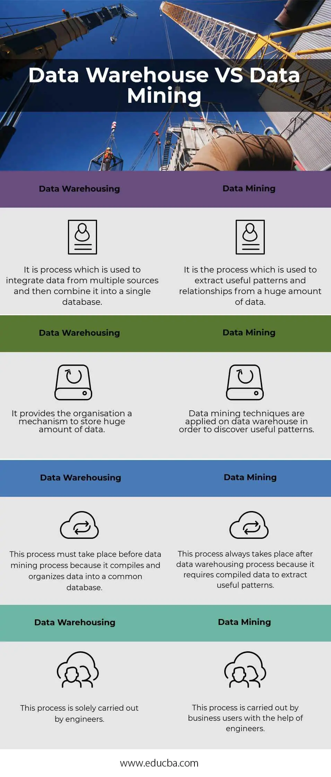

Slide 34
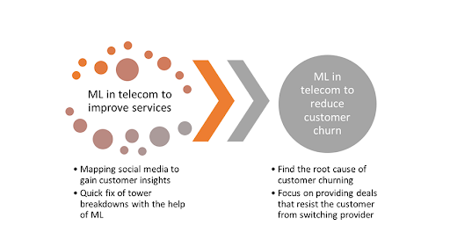

Slide 35
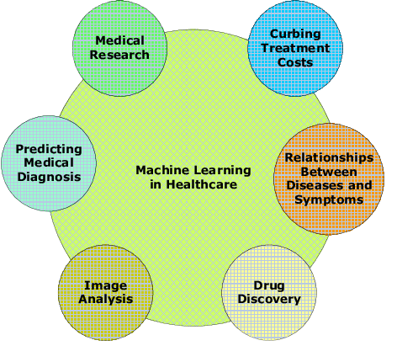

Slide 36
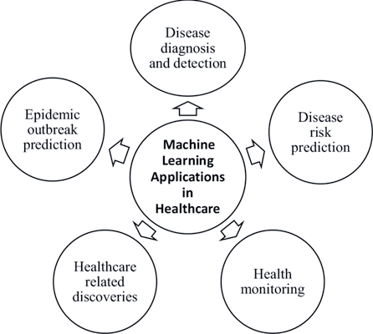

Slide 37


